Slide 1

BOTASTRA presents
Pitch-a-bot
Name: Shivam Ojha
Admn no.: 21je0881
Problem Statement No. : 8

Slide 2
Understanding the problems
1. Nowadays we are becoming increasingly reliant on online shopping platforms like Amazon and Flipkart, which have their widespread supply and transport chains all over the country which deliver our packages right to our house.
2. But many times in this fast-paced world, we aren't able to receive the package at the time of delivery in case if we aren't at home at that exact time due to any other reason. In such cases, the delivery is usually postponed to the next day which causes problems if the item is an important one to be delivered in time.
3. To solve this problem, you as a young engineer are consulted to come up with a possible solution for this problem.

Slide 3
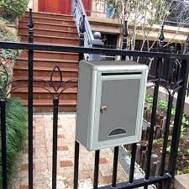
Idea And Approach
So the basic Idea/Solution for the given problem can be installation of a metal mail box outside of our homes with an inbuilt system connected to an electronic lock which will be locked as soon as the parcel is delivered and will open only using a specific 5 digit code which will be emailed to the user on his/her respective email.
This system will be connected to the home Wi-Fi for generating and sending the link to the respective user on their emails.

Slide 4
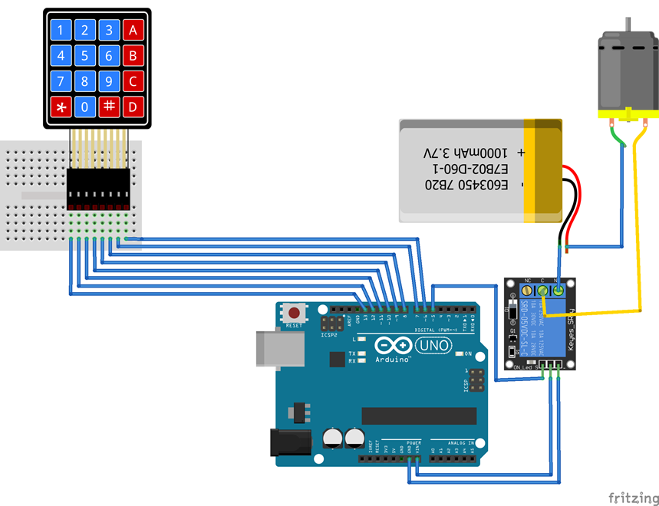
Components Required
Arduino board
NumPad
Breadboard
Relay Module
Battery
Solenoid Lock/Servo Motor
Connecting wires

Slide 5

CONNECTION AND CIRCUIT DIAGRAM
Solenoid Lock
**A Servo Motor Can Also Be used instead of the solenoid
Lock but the solenoid lock is more efficient and secure than the servo motor mechanism.

Slide 6
PSEUDOCODE
The Basic Idea Of our electronic delivery system project is-
The User will receive an online system generated 5 digit code on his email by the company when his package is out for delivery. This 5 digit random code can be generated by using Random() & RandomSeed() function in Arduino.
When the Package is delivered manually into the box the delivery person will have to press ‘#’ button on the numpad to ensure that the mail box is locked.
Now as the box is locked the user can now open the box only by the code on the mail, so as the user enters the code, the Arduino checks out whether the code matches and if it does the relay module sends a signal to the lock and it opens
To lock the box again the user may press ‘#’ again and it will be locked
The Code to be uploaded in Arduino for the system to work is –

Slide 7
PSEUDOCODE
#include <Keypad.h>
char * password = “36904”; // To increase the passcode length change the numerical to the size after position
int position = 0;
const byte ROWS = 4; // 4 rows const byte COLS = 4; // 4 columns
char keys[ROWS][COLS] = { {‘1′,’2′,’3′,’A’}, {‘4′,’5′,’6′,’B’}, {‘7′,’8′,’9′,’C’}, {‘*’,’0′,’#’,’D’} }; //mapping of the keys done w.r.t to the grid keypad
byte rowPins[ROWS] = { 13, 12, 11, 10 }; //connection of rows pins to the Arduino byte colPins[COLS] = { 9, 8, 7, 6 }; // connection of the columns pins to the Arduino
Keypad keypad = Keypad( makeKeymap(keys), rowPins, colPins, ROWS, COLS );
…..[Continued]

Slide 8
PSEUDOCODE
int Lock = 5; // Connecting the relay to the 5th pin
void setup() {
pinMode(Lock, OUTPUT); LockedPosition(true); }
void loop() { char key = keypad.getKey(); if (key == ‘#’) { position = 0; LockedPosition(true); } …..[Continued]

Slide 9
PSEUDOCODE
if (key == password[position]) { position ++; } if (position == 5) // change this if you want to increase the password length { LockedPosition(false); } delay(100); } void LockedPosition(int locked) {
if (locked) { digitalWrite(Lock, LOW); } else { digitalWrite(Lock, HIGH); } }

Slide 10
TAKEAWAY
I’ve learnt lots of new stuff related to Robotics, electronics and every basic Devices & Appliances that we use in our day to day life and what's the basic principle on which they work.
I could have replaced the NumPad with an IoT platform and used an App such as Blynk for the user to enter the code and as the Mail box will be connected to home Wi-Fi, in this way it could have been operated wirelessly through the users phone only, as the code user need to enter would be on the App.
I tried the whole wireless perspective of the project but using the IoT platform and writing the code for the user to enter the password on Blynk was quite tough for me so hence finally I had to include a NumPad.

Slide 11
RESOURCES
RoboISM workshop
Google
YouTube
GitHub
Fritzing Software.
75%
83%
42%
17%
RoboISM Workshops
GitHub
Google & YouTube
Fritzing Software

Slide 12

Thank you!

